Slide 1
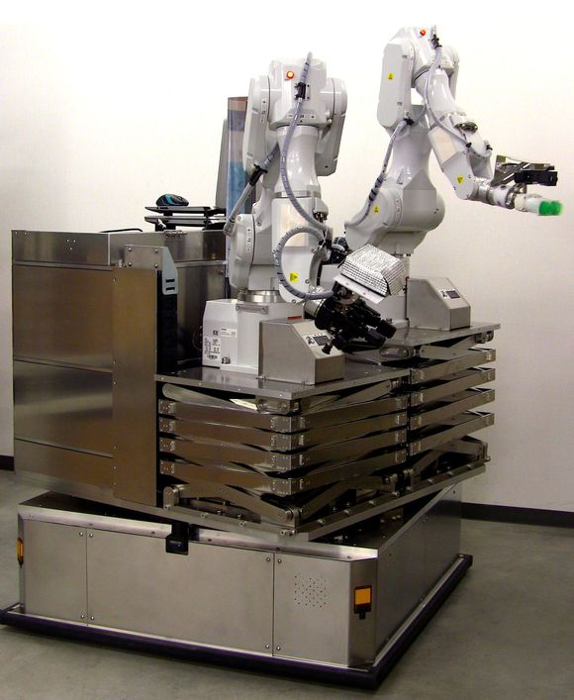
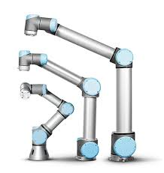
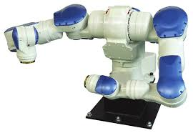
Robot Cost Predictive Model
Data Science Program @ GA, Sydney
Aug 2016
By Ben Huang

Slide 2
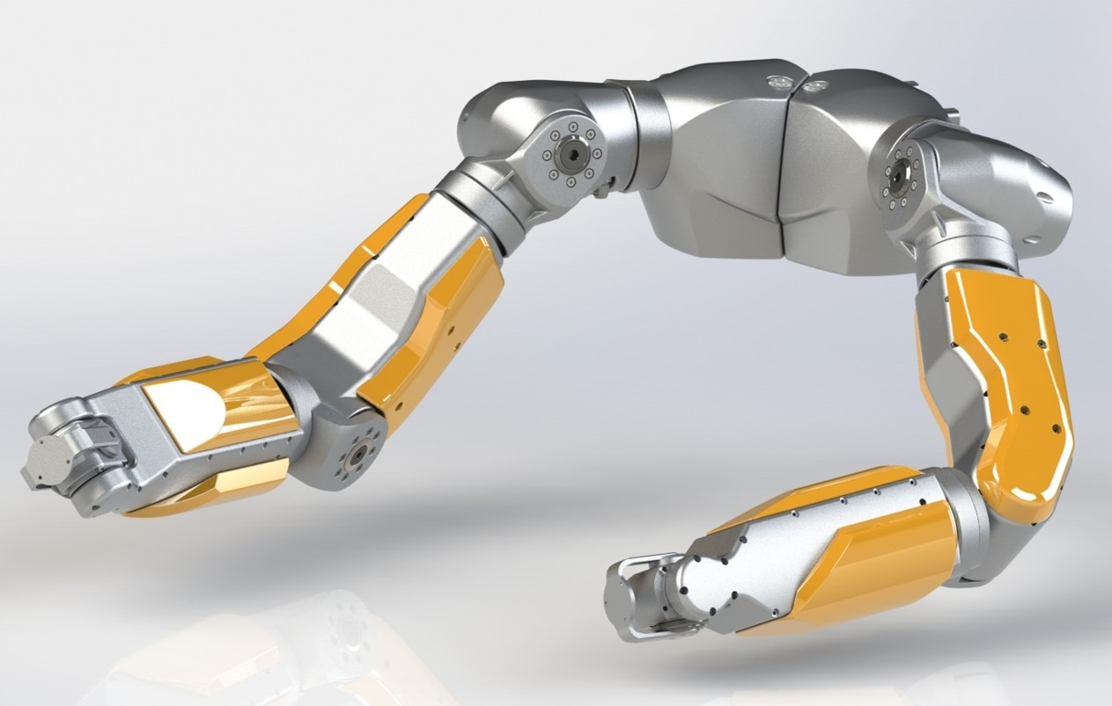
Content
Introduction
Data Acquisition
Data Pre-processing
Data Exploration
Linear Regression
Model Evaluation
Model Interpretation
Prediction based on model
Further Work

Slide 3

Introduction
Background
Objectives
Collect and store past robot quotation data
Identify features that affect robot price (fast review)
Understand how features affect robot price (negotiation)
Create an accruate predictive model to predict price
Method
Quotation data crawling & extraction manually
Discussion with experienced robotic engineers
Linear Regression

Slide 4

Data Acquisition & Pre-processing
Two existing excel datasheets with features and pricing data
Only data relevant to robot by filtering out other products
Filtered out budgetary pricing data
Selected data of the interested robot strength range
Merged two existing datasheets

Slide 5

Data Acquisition & Pre-processing
Other features data were scattered everywhere within the company’s filing system in various formats, for example, supplier’s technical dataset, quotation, customer specification docs, in words, excel, PDF etc.
The hard way – data crawling with my own eyes.

Slide 6
Data Acquisition & Pre-processing
One Hot Encoder
Robust Scaler
Final features include: Robot Strength, First Arm Size, Second Arm Size, Third Arm Size, Second Strength, Shrink Type, High Heat Area, Control Type…etc Total 18 features.
Reasonable 154 samples (covering the popular strength range)
Bias could exist with a few outliner and different suppliers
Issues could happen because of lack of raw material cost data, example iron and copper historical market price

Slide 7

Data Exploration
Statistic by describe()
Correlation Matrix by corr()
Scatter Matrix by scatter_matrix()

Slide 8
Statistic
Run a data.describe() and get the following statistics
Robot_Strength First_Arm_Size Second_Arm_Size Third_Arm_Size Second_Strength
count 156.000000 156.000000 156.000000 156.000000 156.000000
mean 34.597756 42.897436 13.080609 2.072596 2.579327
std 35.837135 27.582484 15.069648 2.317435 4.022937
min 5.750000 5.750000 1.650000 0.000000 0.000000
25% 11.250000 33.000000 2.875000 0.000000 0.000000
50% 25.000000 33.000000 8.250000 2.287500 0.250000
75% 38.125000 55.000000 16.500000 2.750000 4.500000
max 200.000000 132.500000 82.500000 8.250000 15.750000
Annoyance_Score Oil_Consume_Cost Fuel_Consume_Cost Warranty_Years Quantity Supplier_Cost
count 156.000000 156.000000 156.000000 156.000000 156.000000 156.000000
mean 82.275641 1402.575189 241.493881 2.961538 1.621795 256552.191491
std 12.236157 826.894699 170.227702 1.274487 1.860777 139266.535286
min 62.000000 0.000000 0.000000 1.000000 1.000000 71250.000000
25% 70.000000 1000.000000 207.500000 2.000000 1.000000 157161.187500
50% 85.500000 1812.500000 207.500000 3.000000 1.000000 227839.375000
75% 91.250000 1975.000000 318.181818 4.000000 2.000000 307812.500000
max 108.000000 2563.275000 519.750000 8.000000 20.000000 757500.000000

Slide 9
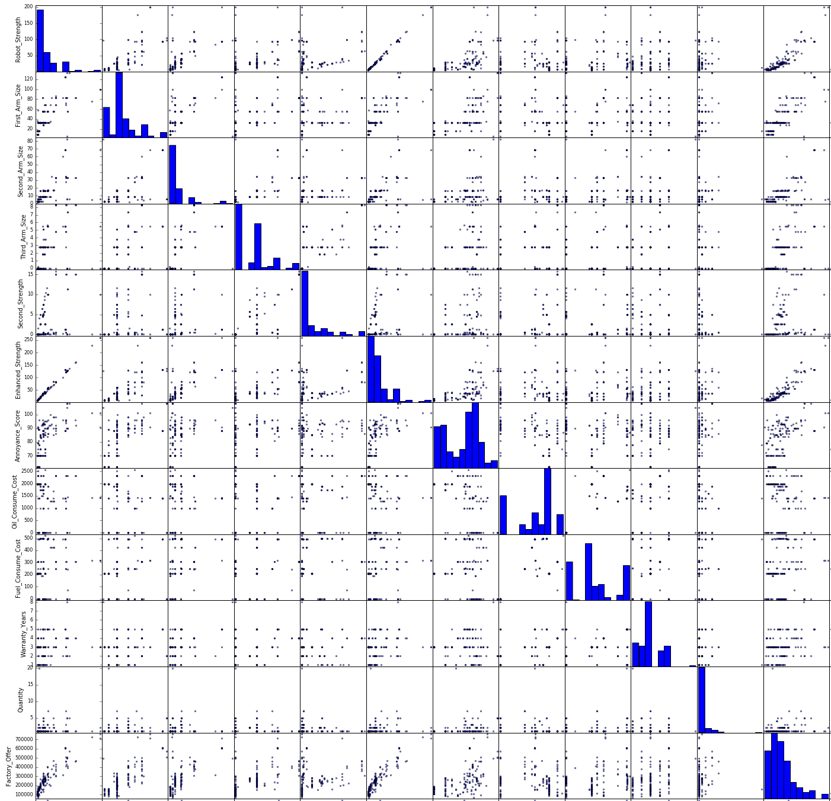
Scatter Matrix

Slide 10
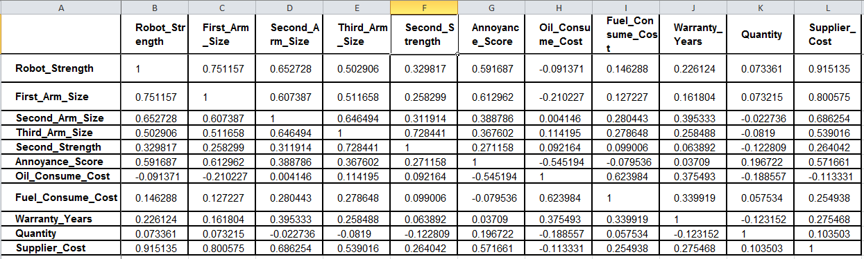
Correlation Matrix
Interesting points:
Robot Strength has a high correlation score of 91.5 % with the supplier cost
Quantity has a small correlation score of 11%
Oil Consume Cost is inversely correlated with the supplier cost with small score of -11%

Slide 11
Machine Learning
Two approaches:
Simple Linear Model with one feature (Robot Strength)
Overfit Linear Model with all features
Linear Regression Model that were experimented
Ransac
Theil-Sen
OLS
Ridge
Elastic_Net
Lasso

Slide 12
One Feature Approach Linear Regression Models Evaluation
Model | Coefficient | Comments
Theil-Sen | 5100 ~ 5250 | Lightly fluctuating coefficients, worth investigating
Ransac | 3000 ~ 6000 | Extremely unstable coefficients create uncertainty about the accuracy ; unsuitable for business use
OLS | 3466 | Fixed coefficient
Ridge | 3466 | Fixed coefficient
Lasso | 3466 | Fixed coefficient
Elastic Net | 3465 | Fixed coefficient
Verdict:
OLS, Ridge, Lasso and Elastic Net all gave almost identical coefficient. There any one of those model would represent all four models. Elastic Net was chosen to proceed with multiple feature model as it includes the power of both Lasso and Ridge.
Ransac has a highly unstable coefficient therefore it creates too much uncertainty.
Theil-Sen has a lightly fluctuating coefficient. It’s worth for investigation

Slide 13
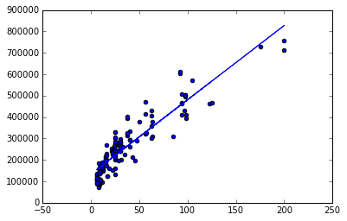
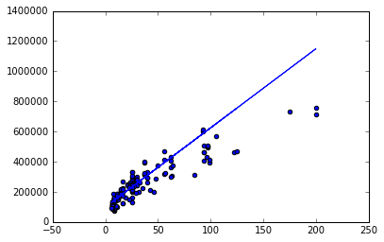
One Feature Approach Elastic Net Model & Theil-Sen Scatter Plot
Elastic Net Scatter Plot
Robot Strength Vs price
Theil-Sen Scatter Plot
Robot Strength Vs price

Slide 14
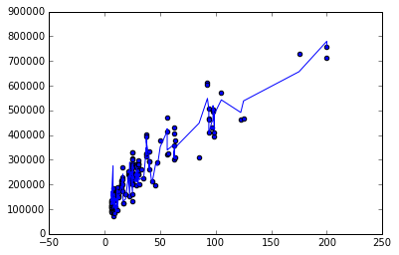

Multiple Features Approach Elastic Net Model & Theil-Sen Scatter Plot
Elastic Net Scatter Plot
Robot Strength VS price
Theil-Sen Scatter Plot
Robot Strength VS price

Slide 15
Multiple Features Approach Elastic Net Coefficient and Intercept
Features | Coefficient | Features | Coefficient
Robot Strength | 2895 | Control Type | 8074
First_Arm_Size | 1065.881 | Control Tech | -5833
Second_Arm_Size | -71.00 | Instrument No | 3695
Third_Arm_Size | 4954 | Oil Consume Cost | -42
Strink_Type | -3696.428 | Fuel Consume Cost | 181
High_Heat_Area | 3746 | Warranty Years | 4393
Med Thermal Req | 1120 | First Arm Type | 3934
High Thermal Req | 1490 | Second Arm Type | 2742
Noise Score | -922.79 | First_Second_Link | 509.6
Quantity | 1298
Additional Note - Intercept is 138,816 (which is strangely high…)

Slide 16
Multiple Features Approach Theil Sen Coefficient and Intercept
Features | Coefficient | Features | Coefficient
Robot Strength | 3586 | Control Type | 19792
First_Arm_Size | 593 | Control Tech | -39561
Second_Arm_Size | -751 | Instrument No | 3183
Third_Arm_Size | 16761 | Oil Consume Cost | -50
Strink_Type | -38267.428 | Fuel Consume Cost | 250
High_Heat_Area | 35789 | Warranty Years | 6206
Med Thermal Req | 7166 | First Arm Type | 5616
High Thermal Req | 2514 | Second Arm Type | 13054
Noise Score | -1433.18 | First_Second_Link | 71178
Quantity | 10473
Additional Note - Intercept is 91789(better but still high..)

Slide 17
Elastic Net Model Evaluation
Three model evaluation methods were applied:
Split, Train and Test with Test Size of 0.2
Grid Search with the following parameters
Grid Search Parameters | Values
Max_inter | 10,000
Fit_intercept | True, False
normalize | True, False
Copy_X | True, False
l1_Ratio | 0.3, 0.5, 0.7
Warm_start | True, False
Selection | Cyclic, random
CV (folds) | 10

Slide 18
Elastic Net Model Evaluation Score
Split Train & Test Score Items | Score
Explained Variance Ratio | 0.91
Mean Absolute Error | 32349
Median Absolute Error | 19032
R2 | 0.90
Grid Search Score Items | Score
Mean Absolute Error | 33539
Median Absolute Error | 26042
R2 | 0.85

Slide 19
Theil Sen Model Evaluation
Three model evaluation methods were applied:
Split, Train and Test with Test Size of 0.2
Grid Search with the following parameters
Grid Search Parameters | Values
Tolerance | 0.001, 0.005, 0.01
Fit_intercept | True, False
verbose | True, False
Copy_X | True, False
Max iteration | 1000
Warm_start | True, False
Selection | Cyclic, random
CV (folds) | 10

Slide 20
Theil Sen Model Evaluation Score
Split Train & Test Score Items | Score
Explained Variance Ratio | 0.90
Mean Absolute Error | 35332
Median Absolute Error | 24800
R2 | 0.896
Grid Search Score Items | Score
Mean Absolute Error | 31267
Median Absolute Error | 21032
R2 | 0.82

Slide 21
Elastic Net Or Theil Sen?
Elastic Net Score Summary
Theil Sen Score Summary
Split Train & Test Score Items | Score
Explained Variance Ratio | 0.91
Mean Absolute Error | 32349
Median Absolute Error | 19032
R2 | 0.90
Split Train & Test Score Items | Score
Explained Variance Ratio | 0.90
Mean Absolute Error | 35332
Median Absolute Error | 24800
R2 | 0.896
Grid Search Score Items | Score
Mean Absolute Error | 33539
Median Absolute Error | 26042
R2 | 0.85
Grid Search Score Items | Score
Mean Absolute Error | 31267
Median Absolute Error | 21032
R2 | 0.82

Slide 22
Elastic Net Or Theil Sen?
Both model after applying Grid Search scored very similarly.
More inclined towards Theil Sen although smaller R2, particular when robot strength < 150.
Reason:
Outliners excluded
More realistic feature coefficient values because robot strength effect is reduced.
Easier to present for business use.

Slide 23
Theil Sen Model Interpretation
Features | Coefficient | Features | Coefficient
Robot Strength | 3586 | Control Type | 19792
First_Arm_Size | 593 | Control Tech | -39561
Second_Arm_Size | -751 | Instrument No | 3183
Third_Arm_Size | 16761 | Oil Consume Cost | -50
Strink_Type | -38267.428 | Fuel Consume Cost | 250
High_Heat_Area | 35789 | Warranty Years | 6206
Med Thermal Req | 7166 | First Arm Type | 5616
High Thermal Req | 2514 | Second Arm Type | 13054
Noise Score | -1433.18 | First_Second_Link (%) | 71178
Quantity | 10473
Additional Note - Intercept is 91789(better but still high..)

Slide 24
Observed
Based on data exploration and feature coefficient study, the following insights were observed:
The higher robot strength, the higher dominant effect it has on price, as demonstrated by removing the outliners.
The oil consumption cost set by the customer doesn’t affect the price offer provided by the supplier. One explanation is that our supplier tends to provide efficient robot without the needs of customer’s requirement. This point can be verified by looking at the past oil consumption rate data.
It was a common understanding that as the required quantity of a robot design increases, the cost per unit should decrease. However, the data shows that the impact of quantity on cost is negligible when it’s below the number of 10.
Also the Second Arm Size feature surprised the most as it has been understood that as the second arm size increase, cost would go up. But the coefficient indicates that it’s inversely proportional to the cost. This point requires more review..
Now I may know something that other experienced engineers don’t know!

Slide 25


Application of the model
Currently working on a new inquiry. The overfit model was used to predict three units with robot strength of {7.5, 7.5 & 10}
Two predicted values were on the spot
Another one exceeded
the realistic price by %60

Slide 26

Further work
Collect more data
Review data
Further Investigation of Features Correlation, e.g PCA
Other regression model, e.g working with warranty
Study into Statistic theories and meaning
Investigating Price Per Strength as Y variable

Slide 27

Thank You for Listening

